Slide 1




Super Store Analysis Project
March 29, 2025
1

Slide 2
Team Members:
- Mohamed Ahmed Taha. (Data cleaning, Modeling and Dashboard)
- Abdelrahman Yehia. (Data cleaning, Technical report)
- Saleh Mohamed.
- Mahmoud Al-Araby. (Presentation , Technical report)
Date:[March 29, 2025]
March 29, 2025
1

Slide 3
Project Idea
Brief Description of the Problem:
Overview of what we did:
Unique Value Proposition:
- Fast and detailed analysis of sales data with interactive visuals.
- Easy identification of top-performing products and regions.
- Data-driven insights to improve performance and boost sales.
Superstore struggles with inefficiencies in sales performance, shipping delays, and regional variations, leading to potential revenue losses ($4,600 estimated cost from shipping delays across 100 orders). The dataset requires detailed analysis to uncover trends and optimize operations.
A Power BI-based analysis was conducted to clean, model, and visualize the Superstore dataset. Two dashboards (Strategic and Analytic) provide insights into sales trends, customer behavior, shipping efficiency, and regional performance to support data-driven decisions.
March 29, 2025
2

Slide 4
Project Wireframe
Visual Representation of User Interface:
- The dashboards provided showcase the main user interfaces:
Strategic Dashboard:
2. Analytic Dashboard:
Displays key metrics like total sales ($2.3M), total profit ($286.4K), total orders (9994), total customers (793), and total returns (296). It also includes visualizations such as sales by month, region, category, and state.
Focuses on detailed insights like top customers (Brosina Hoffman: $3,473.90), shipping delays by mode ( Standard Class: 4.8 days), and category performance ( Technology: $5,989.50).
March 29, 2025
3

Slide 5
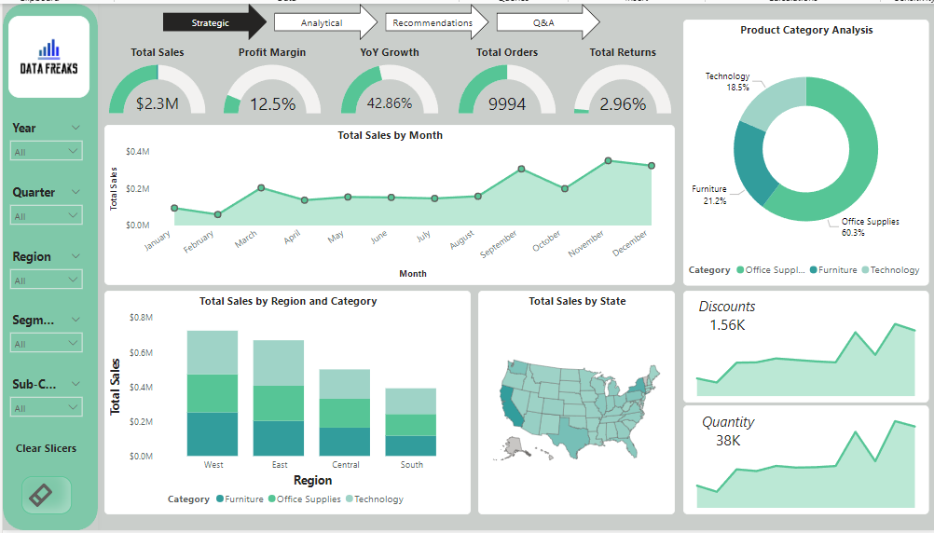
Strategic Dashboard
4
March 29, 2025
‹#›

Slide 6
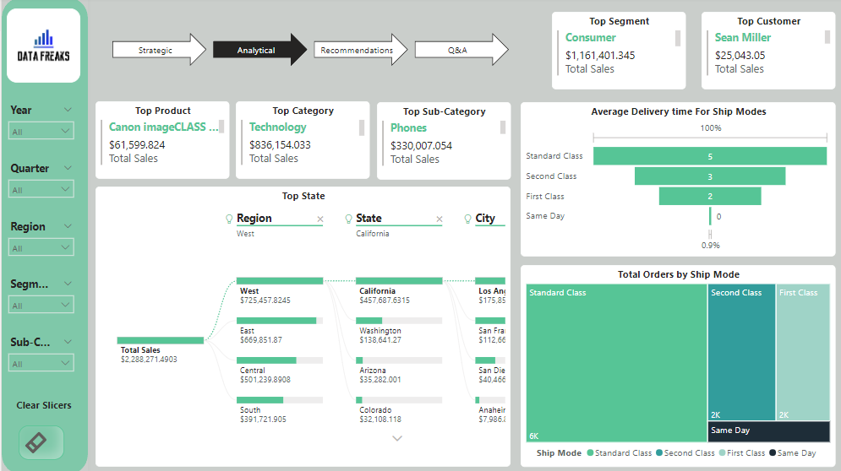
Analytic Dashboard
March 29, 2025
5

Slide 7
End Users & Features
Target Users
- Business Managers:
To monitor sales trends (e.g., Q4: 36% of sales) and shipping delays (e.g., Standard Class: 4.8 days).
- Sales Teams:
To target high-value customers ( Brosina Hoffman: $3,473.90) and regions ( West: $10,135.47).
- Logistics Teams:
To optimize shipping modes (e.g., reduce Standard Class delays).
March 29, 2025
6

Slide 8
Key Features:
-Interactive visuals for sales by region, category, and quarter.
Customer segmentation analysis ( Consumer: 54% of sales, Home Office: longest delays at 4.9 days).
Shipping delay insights ( Standard Class: 70% of orders, 4.8-day delays).
Problem Solving:
Identifies operational weaknesses (, Furniture delays: 4.9 days) to reduce costs.
Highlights high-risk customers ( Hoffman, Blumstein) for priority shipping.
Recommends regional focus ( improve Central’s efficiency, leverage East’s shorter delays).
March 29, 2025
7

Slide 9
Data Structure
Description of the Database:
- The dataset includes:
Order Info: Order ID, Order Date, Ship Date, Ship Mode (Standard Class, First Class).
Customer Info: Customer ID, Name, Segment (Consumer, Corporate, Home Office).
Product Info: Product ID, Category (Furniture, Technology), Sub-Category.
Financial Metrics: Sales ($22,514.18 for 100 orders), Discount, Profit.
Geographical Data: City, State, Region, Postal Code.
Data Flow:
Collection: Extracted from Superstore’s sales records.
Cleaning: Removed duplicates (2 rows), fixed missing postal codes (e.g., Burlington, VT: 5401), corrected San Diego’s postal code (92024 to 92124).
Modeling: Split into dimension tables (dCustomer, dLocation, dShipping, dProduct, dCalendar) and a fact table (fSales).
Access: Visualized in Power BI for stakeholder analysis.
March 29, 2025
8

Slide 10
Programming Languages
Programming Languages:
DAX: Used for calculated columns ( Delivery Time = Ship Date - Order Date) and measures
Power Query : For data cleaning ( removing duplicates, fixing postal codes) and creating the dynamic dCalendar table.
Supporting Technologies:
xlsx File Handling: Imported dataset into Power BI.
Data Modeling: Created dimension tables (e.g., dProduct, dLocation) and resolved many-to-many issues
March 29, 2025
9

Slide 11
Live Application & Test
Current Status:
The application is in the Beta Phase, with fully functional Strategic and Analytic Dashboards deployed on Power BI. The analysis covers the first 100 transactions, revealing key trends (e.g., Q4 sales: $8,163.59).
Testing Phases:
Data Validation: Ensured data integrity by removing duplicates and fixing postal codes.
Model Testing: Verified relationships between tables ( one-to-many between dLocation and fSales).
User Testing: Shared dashboards with stakeholders to validate insights ( shipping delays impacting profitability).
March 29, 2025
10

Slide 12
Deliverables
Documentation:
Technical report detailing data cleaning ( removed duplicates, fixed postal codes), modeling ( dimension tables, dCalendar), and insights.
User guide for navigating Power BI dashboards.
Final Products:
Power BI dashboards (Strategic and Analytic).
Cleaned and modeled dataset with dimension tables.
Comprehensive report with recommendations (e.g., optimize Standard Class shipping).
March 29, 2025
11

Slide 13
Recommendations
Product & Category Strategy:
1.Expand Technology Offerings:
With Technology the top category ($836K) and "Phones" as the top sub−category($330K), invest more in high-demand tech products.
Consider adding complementary accessories or newer tech models.
2.Leverage Top Performers:
"Canon image CLASS" is your top product ($61.6K), feature it prominently in marketing and consider bundling it with related office supplies.
3.Optimize Furniture Selection:
While Furniture represents (21.2%) of sales, there may be room to expand higher-margin furniture items given the category’s strong performance.
March 29, 2025
12
March 29, 2025

Slide 14
Sales & Marketing Focus:
Double Down on Consumer Segment:
Your consumer segment generates ($1.16M) in sales, develop targeted loyalty programs and personalized marketing for this group.
Expansion in The West Region:
California is your top state ($457.7K), and the West region leads sales, consider opening new locations or increasing marketing in this high-potential region.
Customer Retention:
"Sean Miller" is your top customer ($25K), implement a VIP program for high-value customers to maintain their loyalty.
Operational Improvements:
Address Returns:
With (2.96%) returns rate , analyze reasons for returns and implement quality control measures, especially in the Office Supplies category (60.3% of sales).
Shipping Optimization:
Standard Class appears to be the dominant shipping method, negotiate better rates with carriers or offer incentives for customers to choose more economical shipping options.
March 29, 2025
13

Slide 15
Project Team
Mohamed Ahmed Taha
Abdelrahman Yehia
Saleh Mohamed
Mahmoud Al-Araby
Collaboration Method
The team collaborated using Zoom and Discord for communication and coordination.
March 29, 2025
14

Slide 16
Thank you!
March 29, 2025
15

